Slide 1
CPBP 8306: Data cleaning day 1
Stevenson Science & Engineering Library
Joshua Borycz

Slide 2
GitHub Desktop

Slide 3
Setting up a GitHub repository
Create a GitHub account
Download and install GitHub desktop
GitHub Desktop > Settings > Sign Into GitHub.com > Follow security instructions in browser
File > New repository > Select name, description, path, initialize README > select none for Git Ignore & License
Publish repository > Choose name, description, & keep code private > none for Organization
Congratulations! The world now knows you can code!
Notes:
we’ll demonstrate how to set up search alerts for queries in databases
Also run through a few searches in these
Mostly focusing on SciFinder

Slide 4
Using a GitHub repository
A commit saves your code at a moment in time with a title and description to a particular branch
A branch is a version of your code that will not impact other versions (main/master branch is like the trunk of the tree)
You can pull (a.k.a. Fetch origin) the remote repository, on GitHub.com to your computer
You can push the local repository, on your computer, to GitHub.com
You can merge branches when you want to combine changes to code. All differences will be tracked.
Notes:
we’ll demonstrate how to set up search alerts for queries in databases
Also run through a few searches in these
Mostly focusing on SciFinder

Slide 5
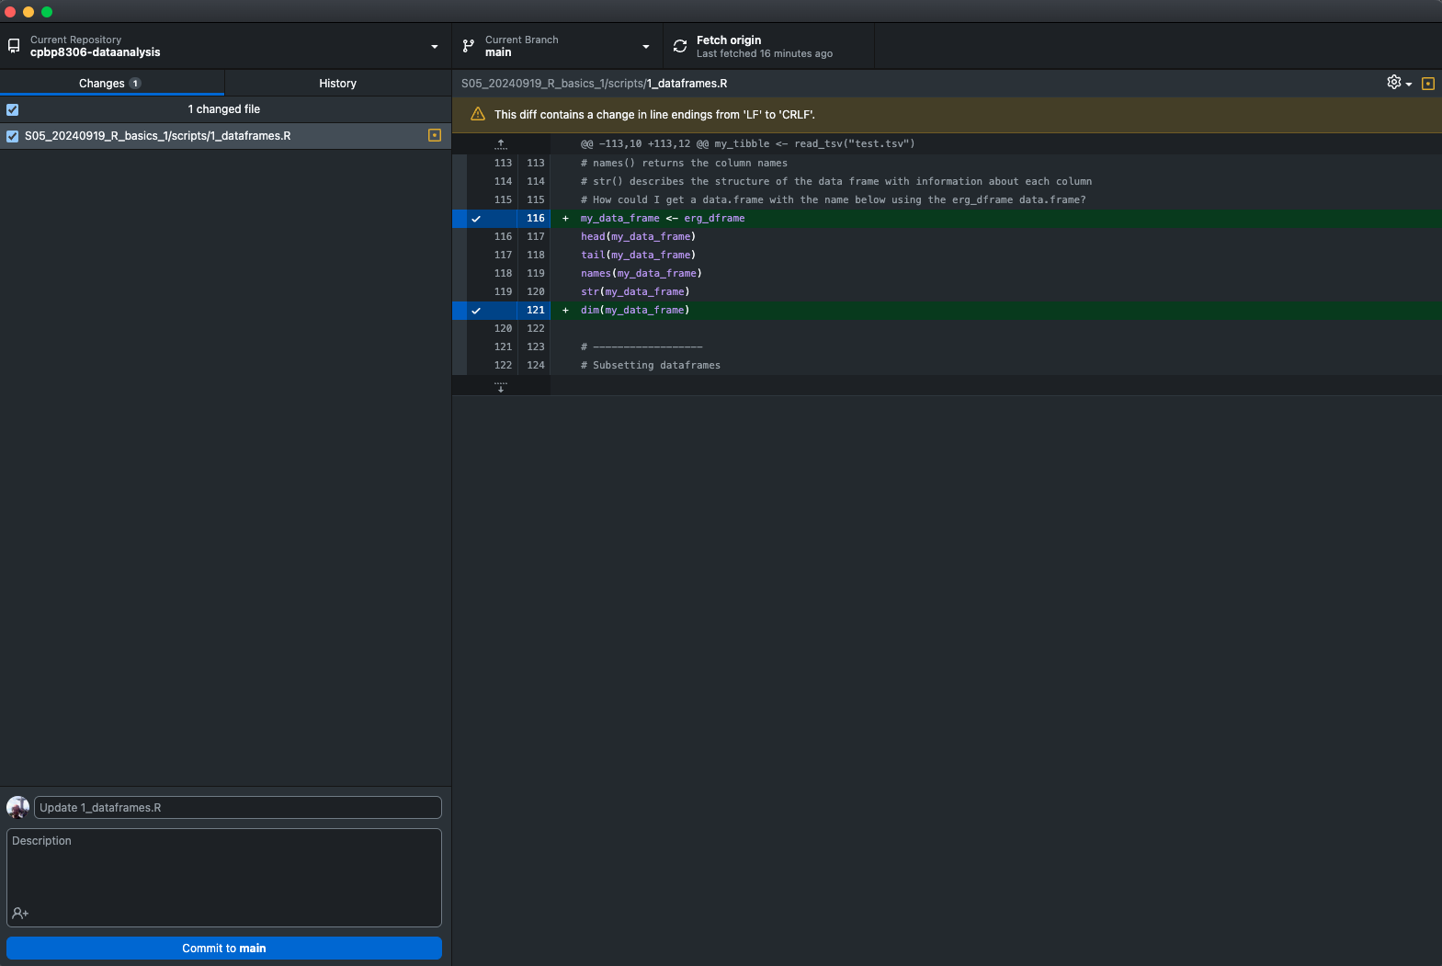
Using a GitHub repository
List of changed files
Changes to code
Write commit
Notes:
we’ll demonstrate how to set up search alerts for queries in databases
Also run through a few searches in these
Mostly focusing on SciFinder

Slide 6
GitHub Desktop

